Slide 1
Comparing Extrapolation Methods: Pulse Stretching and Gate Insertion
November 17, 2020

Slide 2
Randomized Benchmarking
All qubits are initialized in the 0 state
Then we generate a circuit of n gates which add up to identity
Result should be all qubits in 0 state but practically, due to noise, that is dependent on number of gates in the circuit
The more gates, the more noise and hence less probability of getting the initial state
In the following slides, on top of the number of gates, we amplify noise using pulse stretching and gate insertion.
Ideally, extrapolated outcomes should imply that P(initial state) = 1

Slide 3
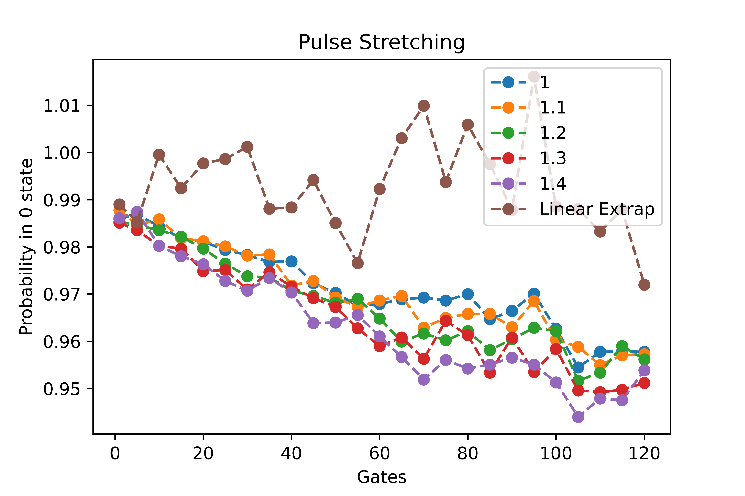
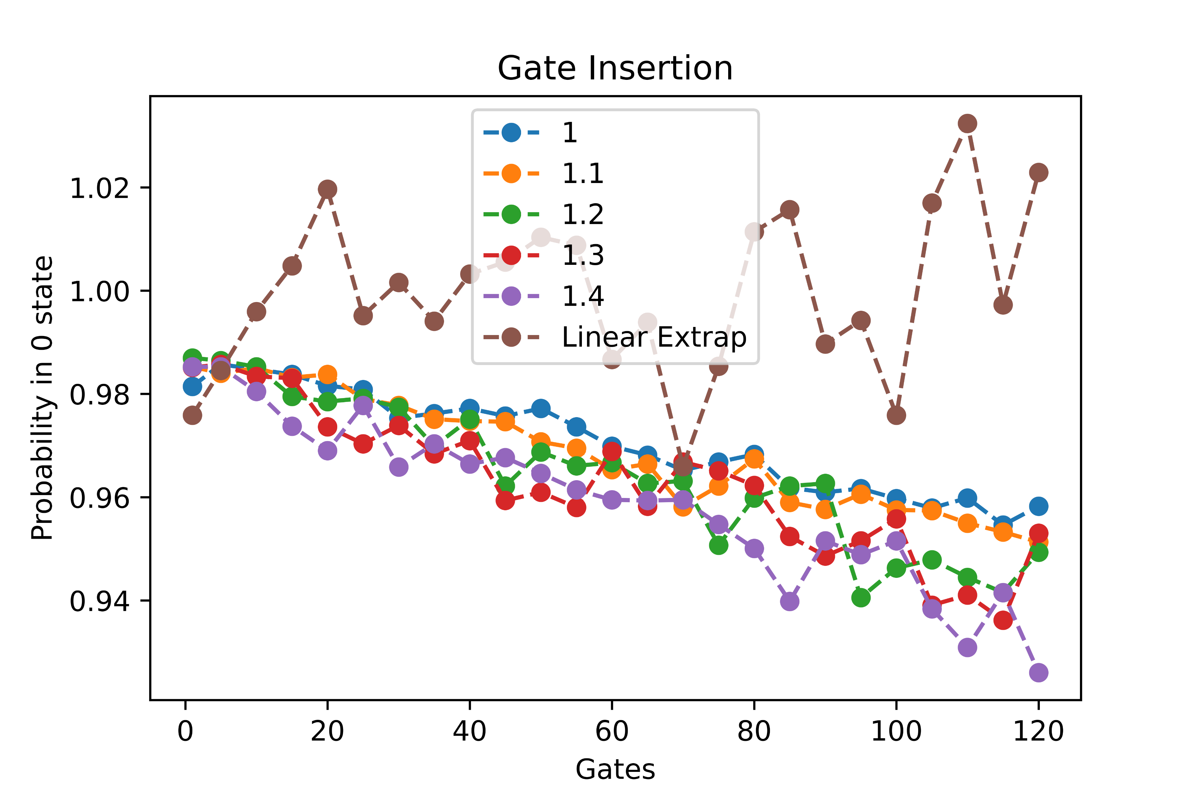
Single Qubit Randomized Benchmarking
Pulse Stretching
Gate Insertion

Slide 4
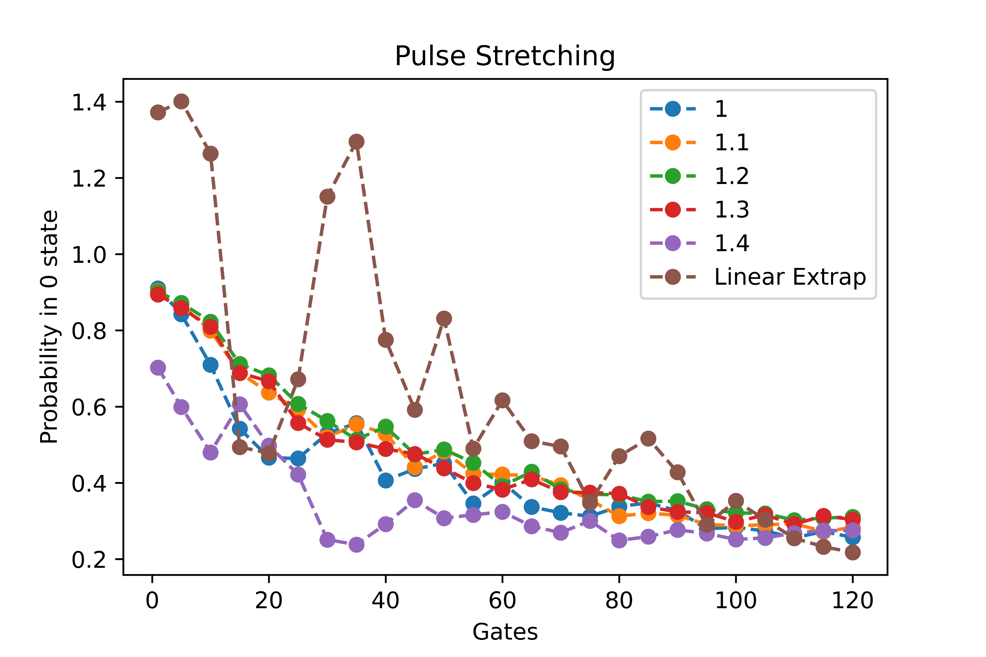
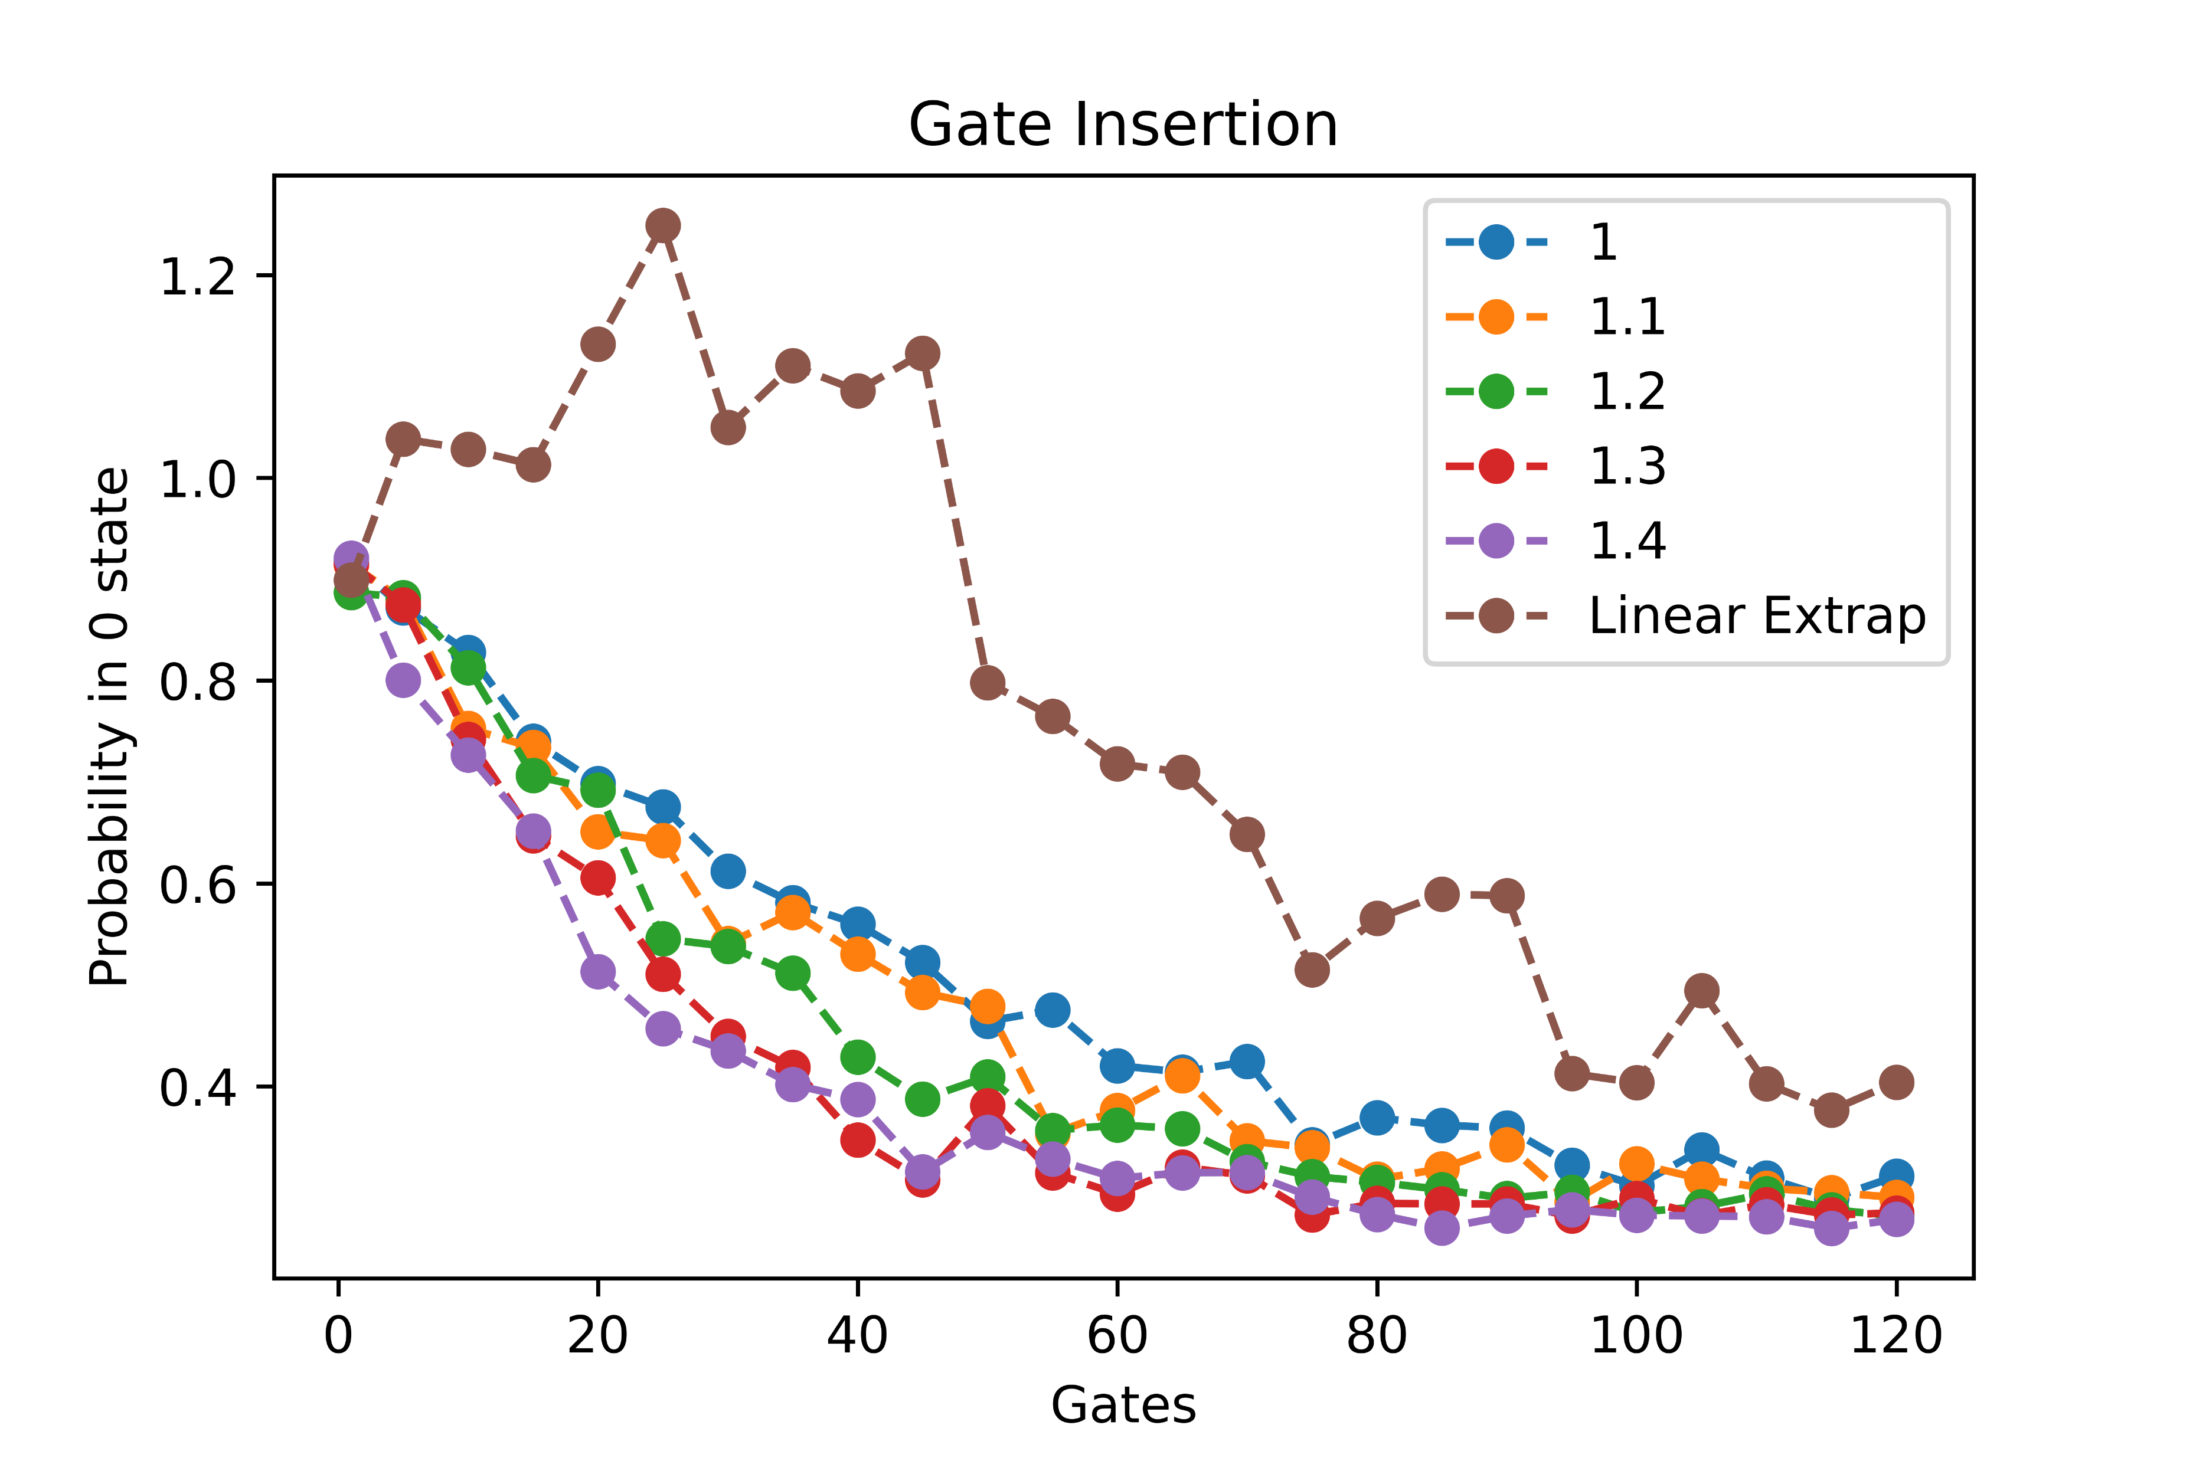
Two Qubit Randomized Benchmarking
Pulse Stretching
Gate Insertion
* The gate count as shown by x axis is representative of the circuit before it went through gate insertion procedure

